Slide 1

Automobile Market Analysis Part-1 and part-2 With Excel File Attachment
ANNAMALAI G
Mentor: Mr. Munna Pandey

Slide 2
INTRODUCTION
➤ In the current competitive Automobile market each and every car manufacturers are facing evolving market where the drivers are becoming eco-friendly, Fuel efficiency has become their top priority as well as safety features in cars alongside performance.
➤ In order to analyse the various shifts, trends and efficiency in the automobile industry DATA ANALYTICS has been used at every stage of automobile production.
➤ In this project, Smith a data analyst with a popular automobile giant need to analyse a car dataset and identify the potential models to launch and present insights about the most diverse car manufacturer in the given country.
➤ A data set containing all the details of the automobile production of car manufacturers has been given. Various business questions is been solved to arrive at the conclusion.

Slide 3
BUSINESS QUESTION 1
Identify the top 10 cars with highest miles per gallon. Also, the name of the manufacturers.
BUSINESS QUESTION 2
Identify the top 10 cars with the highest miles per gallon based on displacement. Also identify the name of the manufacturers.
Row Labels | Count of Model
Nexon | 24
Tata | 24
Kuv100 Nxt | 22
Mahindra | 22
Xuv500 | 21
Mahindra | 21
Creta | 18
Hyundai | 18
Innova Crysta | 16
Toyota | 16
Swift | 14
Suzuki | 14
Etios Liva | 14
Toyota | 14
Wagon | 14
Suzuki | 14
Dzire | 14
Suzuki | 14
Ciaz | 14
Suzuki | 14
Yaris | 14
Toyota | 14
Rapid | 14
Skoda | 14
Grand Total | 199
Row Labels | Sum of City_Mileage_km_litre
Bmw | 218.99
Ford | 53.3
Hyundai | 1134.23
Mahindra | 1563.35
Renault | 575.52
Skoda | 418.6
Suzuki | 1937.78
Tata | 923.21
Toyota | 886.17
Volkswagen | 259.6
Grand Total | 7970.75

Slide 4
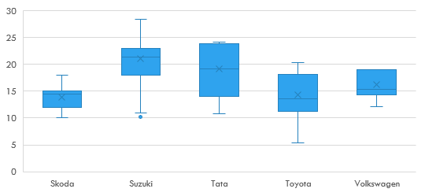
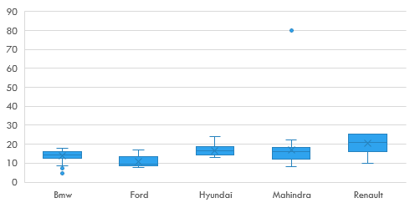
BUSINESS QUESTION 3
Identify the top 3 manufacturers with the highest number of cars of the hatchback body type.
BUSINESS QUESTION 4
Compare the mileages of cars produced by all manufacturers and perform outlier analysis.
Select make, model and body type columns.
Using pivot table identify the top 3 manufacturers of 20 hatchback body type

Slide 5
BUSINESS QUESTION 5
Present the relationship between: 1) Displacement and mileage 2) Mileage and fuel tank capacity
BUSINESS QUESTION 6
Identify a car that would be best for adventurous rides.
Relationship btw Displacement & Mileage
City_Mileage_km_litre | (All)
Row Labels | Max of City_Mileage_km_litre
Mahindra | 80
Suzuki | 28.4
Renault | 25.17
Tata | 24.12
Hyundai | 24
Toyota | 20.32
Volkswagen | 19
Skoda | 18
Bmw | 18
Ford | 17
Grand Total | 80
Relationship btw Fuel tank capacity & Mileage

Slide 6
BUSINESS QUESTION 7
Present the relationship between: 1) Displacement and mileage 2) Mileage and fuel tank capacity
BUSINESS QUESTION 8
The car manufacturer decides to launch 2 types of cars.
A person choosing a family car may consider the following areas for analysis;
Car size
Engine Power
powerSafety Engine features (Air bags, child safety locks) for adults & children
Mileage
Comfort during long distance travel (Seat material, body type, Brake system, type, Boot space, Fuel tank capacity)
Bulit in entertainment options (Audio system, Infotainment screen, fm radio)
INTERPRETATION:
From Business Qn 7, we can identify that SUZUKI (Celerio & Celerio X)
Row Labels | Sum of Width_mm | Count of Kerb_Weight | Sum of Height_mm | Average of City_Mileage_km_litre
Electric Power | 1096300 | 437 | 998274 | 18.33985994
Electric Power, Hydraulic Power | 1745 | 1 | 1540
Electro-Hydraulic | 97857 | 50 | 82971 | 14.74372093
Hydraulic Power | 45821 | 10 | 43326 | 11.92222222
Yes | 92642 | 36 | 88007 | 14.396
(blank) | 41438 | 21 | 43879 | 14.32933333
Grand Total | 1375803 | 555 | 1257997 | 17.40338428

Slide 7
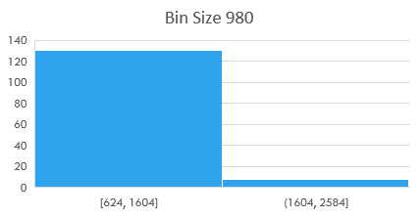
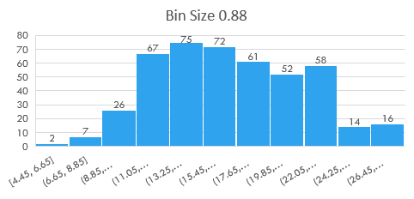
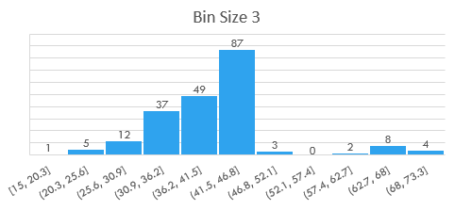
BUSINESS QUESTION 9 Identify the outliers for the following columns using Histogram: Displacement (Bin size: 980), City mileage (0.88), Fuel tank capacity (3). Remove the identified outliers from the dataset.
Displacement (Bin size:980)
City mileage (Bin size :0.88)
Fuel tank capacity (Bin size:3)

Slide 8
BUSINESS QUESTION 10 Identify the top 3 car manufacturers with the highest no. of variants in the following categories:
Body_Type | Hatchback
Row Labels | Count of Body_Type
Suzuki | 96
Hyundai | 46
Tata | 36
Mahindra | 27
Toyota | 25
Renault | 12
Ford | 11
Volkswagen | 10
Grand Total | 263
Body_Type | Sedan
Row Labels | Count of Body_Type
Hyundai | 44
Skoda | 39
Toyota | 32
Suzuki | 31
Volkswagen | 22
Tata | 20
Bmw | 16
Ford | 13
Mahindra | 6
Grand Total | 223
Body_Type | SUV
Row Labels | Count of Body_Type
Mahindra | 77
Hyundai | 40
Tata | 40
Ford | 15
Renault | 13
Bmw | 12
Suzuki | 11
Toyota | 9
Skoda | 4
Volkswagen | 2
Grand Total | 223

Slide 9
BUSINESS QUESTION 11 Identify the most popular car body type, by count from the analysis of Task 2. Car body types can fall under the categories such as SUV, Sedan and Hatchback.
Row Labels | Count of Body_Type
Hatchback | 263
SUV | 223
Sedan | 223
MUV | 32
MPV | 25
Crossover | 10
Coupe | 3
Crossover, SUV | 2
Sports, Convertible | 2
SUV, Crossover | 2
Sedan, Coupe | 1
(blank)
Grand Total | 786
STEPS TO FOLLOW:
➤ Select Body type column.
➤ Create Pivot table and chart.
➤ Identify the count of body type through Value field settings.
➤ Sort the row label from highest to lowest.

Slide 10
AUTOMOBILE MARKET ANALYSIS (PART 2)
BUSINESS QUESTION 1
Identify the top 2 manufacturers who offer widest range of car variants.
Count of Variant | Column Labels
Row Labels | Bmw | Ford | Hyundai | Mahindra | Renault | Skoda | Suzuki | Tata | Toyota | Volkswagen | Grand Total
Hatchback |  | 11 | 46 | 27 | 12 |  | 96 | 36 | 25 | 10 | 263
Sedan | 16 | 13 | 44 | 6 |  | 39 | 31 | 20 | 32 | 22 | 223
SUV | 12 | 15 | 40 | 77 | 13 | 4 | 11 | 40 | 9 | 2 | 223
MUV |  |  |  |  | 11 |  | 4 | 1 | 16 |  | 32
MPV |  |  |  | 8 |  |  | 17 |  |  |  | 25
Crossover |  | 3 |  |  |  |  | 4 | 3 |  |  | 10
Coupe | 3 |  |  |  |  |  |  |  |  |  | 3
Sports, Convertible | 2 |  |  |  |  |  |  |  |  |  | 2
SUV, Crossover | 2 |  |  |  |  |  |  |  |  |  | 2
Crossover, SUV | 2 |  |  |  |  |  |  |  |  |  | 2
Sedan, Coupe |  | 1 |  |  |  |  |  |  |  |  | 1
Grand Total | 37 | 43 | 130 | 118 | 36 | 43 | 163 | 100 | 82 | 34 | 786
Maximum
Suzuki | 163
Hyundai | 130

Slide 11
BUSINESS QUESTION 2
Calculate & compare variations btw City mileage data using different measures of dispersion for the following 3 manufacturers; 1) Tata 2) Maruti Suzuki 3) Hyundai
BUSINESS QUESTION 3
Display & check how city mileage depends on fuel tank capacity using scatter plot along with trend line & Pearson's product moment coefficient. (R)
b) Display & check how displacement depends on fuel tank capacity using scatter plot along with trendline and Pearson's product-moment coefficient (R
Row Labels | Average of City_Mileage_km_litre
Mahindra | 16.8
Suzuki | 21.1
Tata | 19.2
Grand Total | 19.0

Slide 12
BUSINESS QUESTION 5 (B) a) Plot average speeds & distances driven against fuel efficiency to identify trends b) Use scatterplots & correlation matrices to explore relationships between fuel efficiency & other variables.

Slide 13
BUSINESS QUESTION 5 (C) Identify opportunities for reduced emissions: Group cars by fuel efficiency a) Segment cars into categories like High efficiency, moderate efficiency and low efficiency. b) Analyze the distribution of features within each category. c) Identify common characteristics of cars with high fuel efficiency. There are 20 cars under Low fuel efficiency There are 149 cars under High efficiency. There are 116 cars under moderate efficiency.

Slide 14
SUMMARY AND OBSERVATION
➤ Sprint 6 (Task 1 to 3) mainly dealt with identifying the Top car manufacturers and their car models based on many key factors like City mileage, displacement, the bodytype of cars whether hatchback, Mpv, sedan etc. Based on these observations Mahindra and Suzuki manufacturers are doing good compared to other manufacturers and they both are in top 10 lists.
➤ Task 4 and 5 mainly depends upon finding the relationship between various features and capacities between the cars produced by various carmanufacturers. We have used Scatter plot charts which best describes the between two variables. Task 3 deals with outlier analysis, where Hyundai being the manufacturer with more number of outliers which is not that good.
➤ Next 3 tasks viz., 6,7 & 8 mainly depends upon analysis the various features of cars to find the best cars for specific purposes like for adventurous rides, where BMW (X4) MODEL is suitable, for Family usage its identified that Suzuki cars are suitable and for compact car for city usage where Tata (Nano Genx) is suitable.
➤ Each and every charateristics of the cars and their models is been compared here, also based on the customer preferences around the country. Also in order to find the most diverse car manufacturer in the country, we should also identify the competitors of the cars. So under family usage Tata nano gen is the competitor for Suzuki (celerio & celerio x). Under Compact usage Suzuki (Alto 800 tour) is the competitor for Tata (Nano Genx). So the identified cars should work on the features which is better in their competitors to them to gain more efficiency in the automobile world.
➤ In Task 9 & 10, the histogram is created and we have identified the change in histogram when the data is with outliers and without outliers. The top 3 manufacturers under each bodytype is compared also based on the count of variants. In this regard, Suzuki, Hyundai & tata is best with more no. of variants in Hatch back category. Hyundai, Skoda & Toyota is best under sedan category and Mahindra, tata & Hyundai is best under SUV category.
➤ In the Sprint 7 (Project 2) the analysis is mainly based on observing fuel efficiency to understand the driving patterns which further helps in reducing the carbon emissions around the world. The top 2 manufacturers who has the widest range of car variants are; SUZUKI-163 Variants, Hyundai - 130 Variants. The no. of car variants under each bodytype for the 2 manufacturers are are presented with a clustered chart and pivot table.

Slide 15
➤ There is a Positive correlation between Displacement and fuel tank capacity where R = 0.76The fuel Type column which is of categorical variables is been converted into numerical codes using Ctrl F key which helps us to Find and Replace. Here, Petrol-1, CNG-2, , Diesel-3, Petrol & CNG-4, and Hybrid-6. Using the Formulas Combined average mileage (Fuel efficiency) & Distance is found. Fuel efficiency is being compared across make, model & fuel type using bar chart; For Example,
RENAULT cars with fuel type Petrol:
Model Kwid has the Maximum fuel efficiency
RENAULT cars with Fuel type Diesel:
Model Lodgy has the maximum efficiency......
In the same way we can filter for each manufacturer and compare the fuel efficiency.
➤ Relationship between fuel efficiency and other variables like Displacement and Distance is been found using Line chart. There are 20 cars under Low fuel efficiency. There are 116 cars under High efficiency. There are 149 cars under moderate efficiency
➤ The common characteristics of high fuel efficiency cars are;
The Body type of both Mahindra as well as Hyundai is same
The Engine location is also same for both Mahindra and Hyundai.
The Air bags (Driver frontal air bag, front passenger frontal air bag)mis also same
These are some of the common characteristics.
Conclusion:
➤ Based on all these Observations and analysis, as per my vision, it shows that both MAHINDRA and SUZUKI is being the most diverse car manufacturers compared to others based on the measures of dispersion, the city mileage, body type, displacement, their relationship between the fuel efficiency and so on.
➤ From the car dataset analysis, in order to launch potential car models the manufacturers should identify the Customer needs & preferences, do proper production planning, produce cars for suitable purposes, proper advertising strategies to be used etc. can be followed to Sustain in the competitive

Slide 16
THANK YOU

